Slide 1
Foundatoin of computer science
By: Mohamed Agami

Slide 2
Lecture 2
Power supply

Slide 3
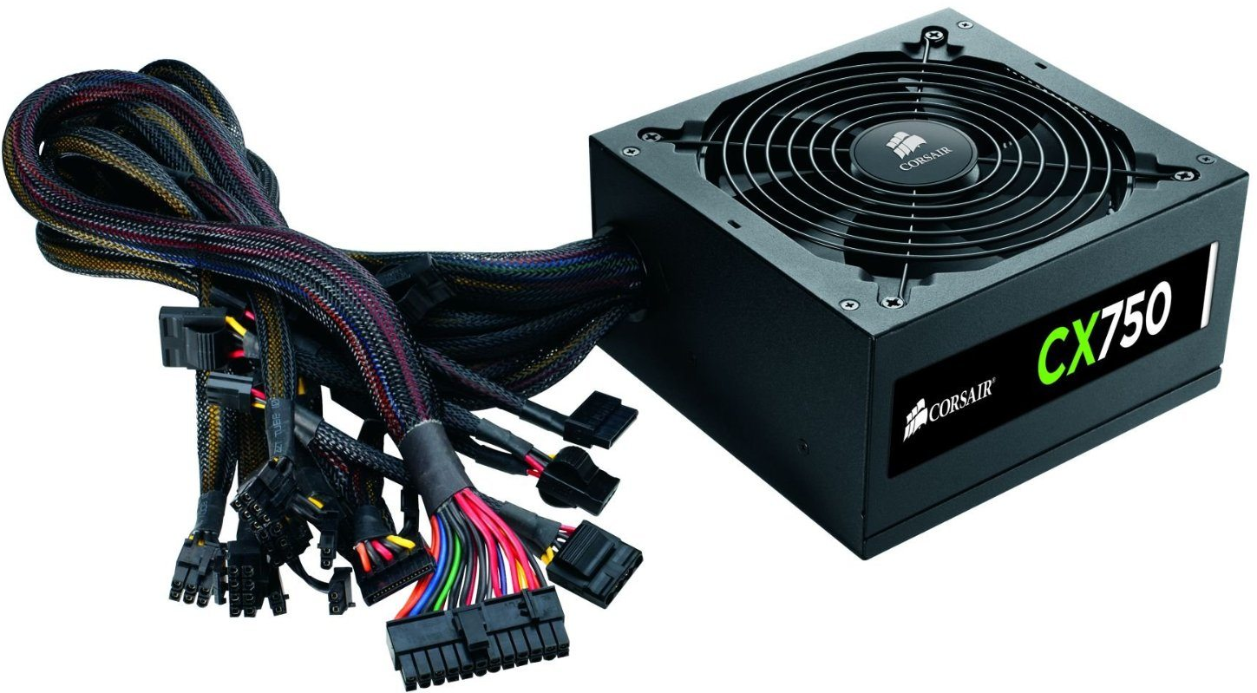
Power Supply

Slide 4




Electricity Unit
VOLT (v)
Measuring the electric potential difference
APM (A)
Measuring the intensity of electric current
WATT (W)
Measuring electrical power
OHM (Ω)
Measurement of electrical resistance

Slide 5

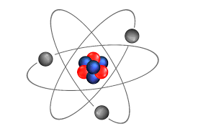
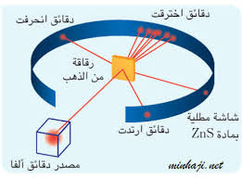

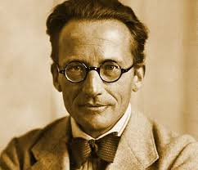
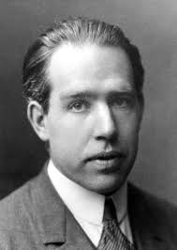

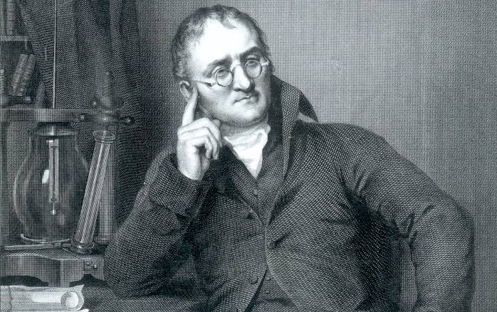
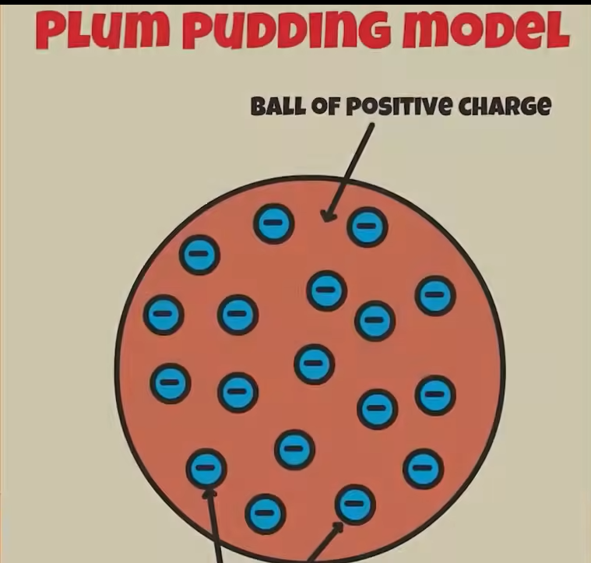
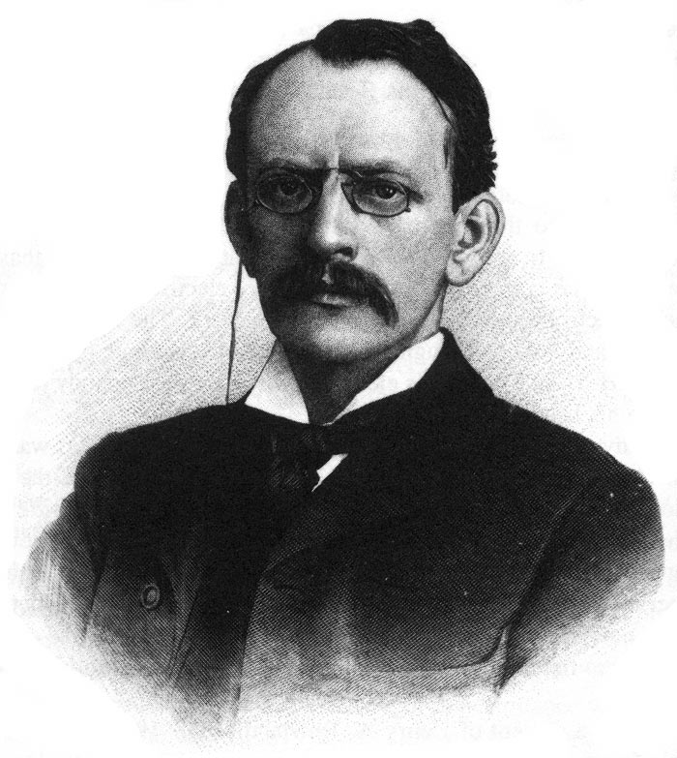
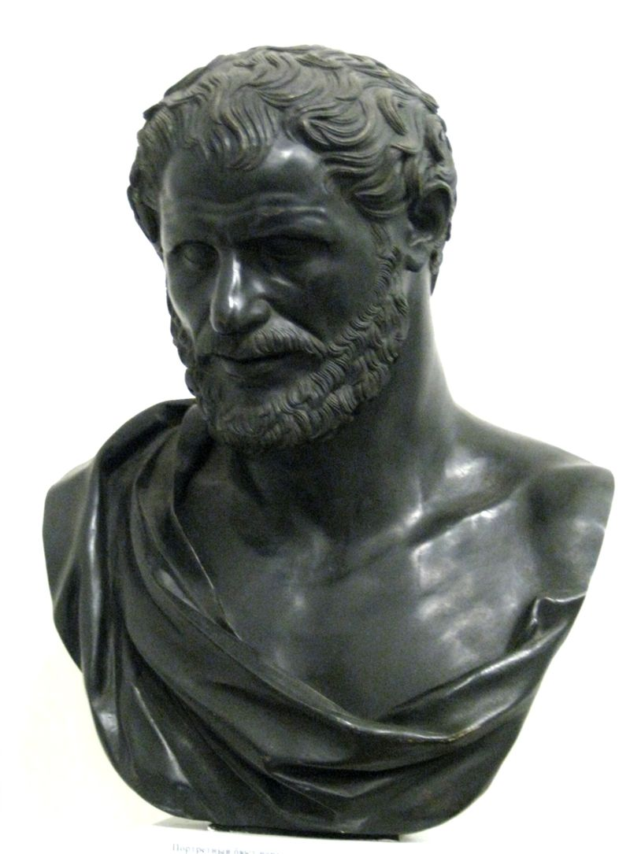
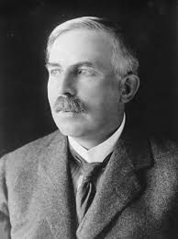
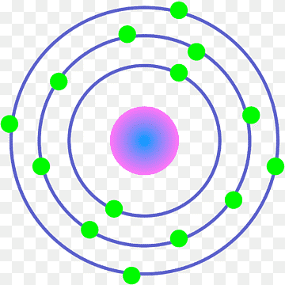

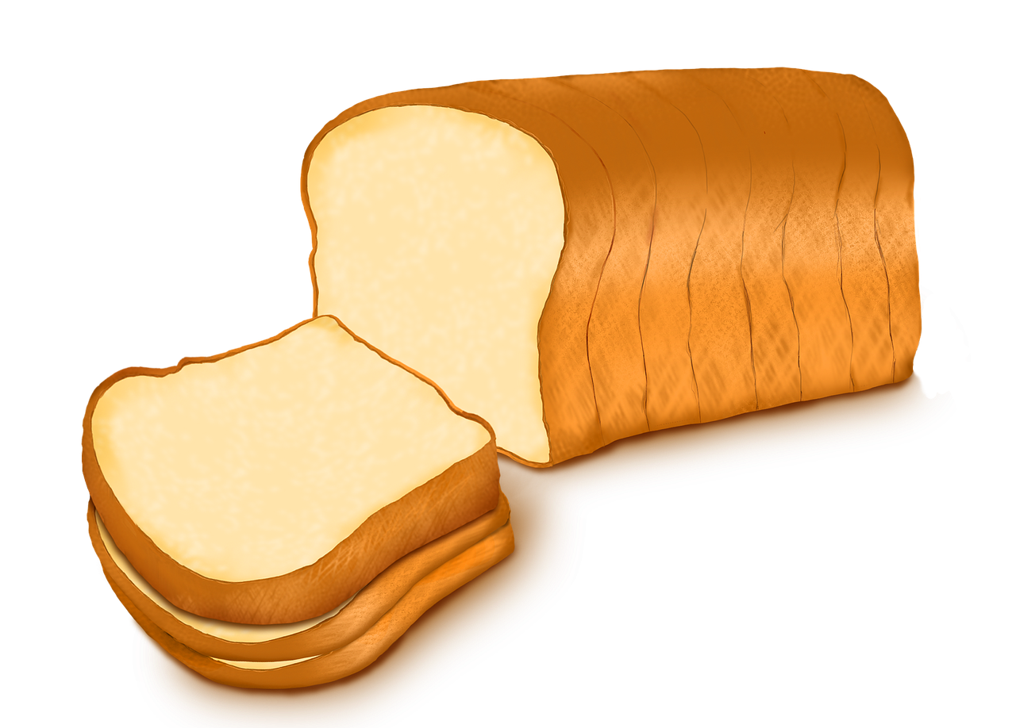
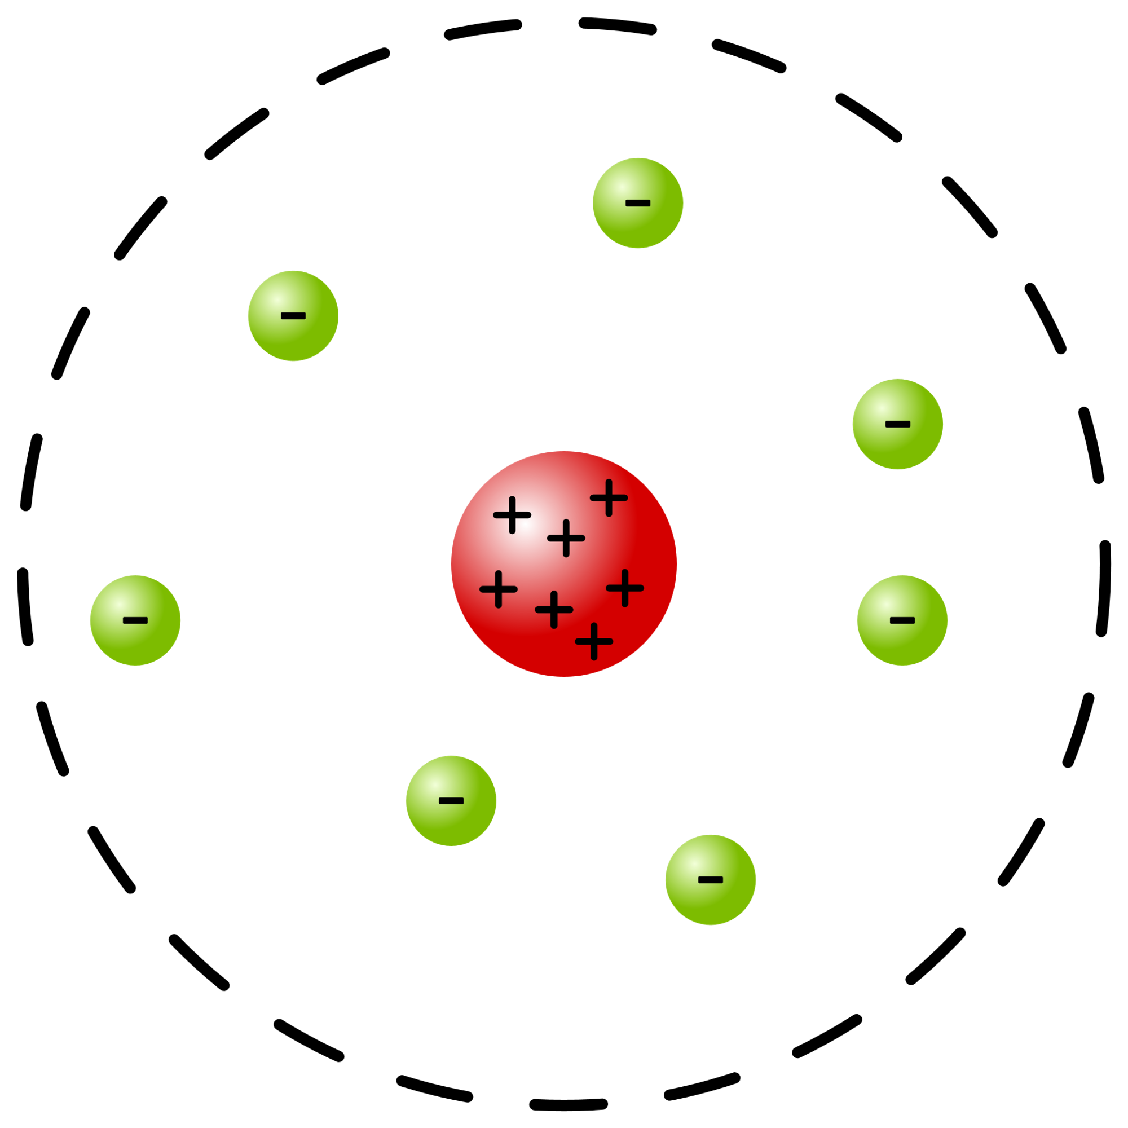
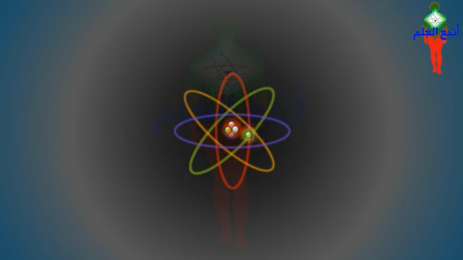


ATOM
.
ATOM
-
Ernest Rutherford 1911
Erwin Schrödinger
1920
Niels Bohr
1913
-
The fourth Qur’an BC
+
=
-
J. J. Thomson 1904
John Dalton 1808
Quantum mechanics model

Slide 6
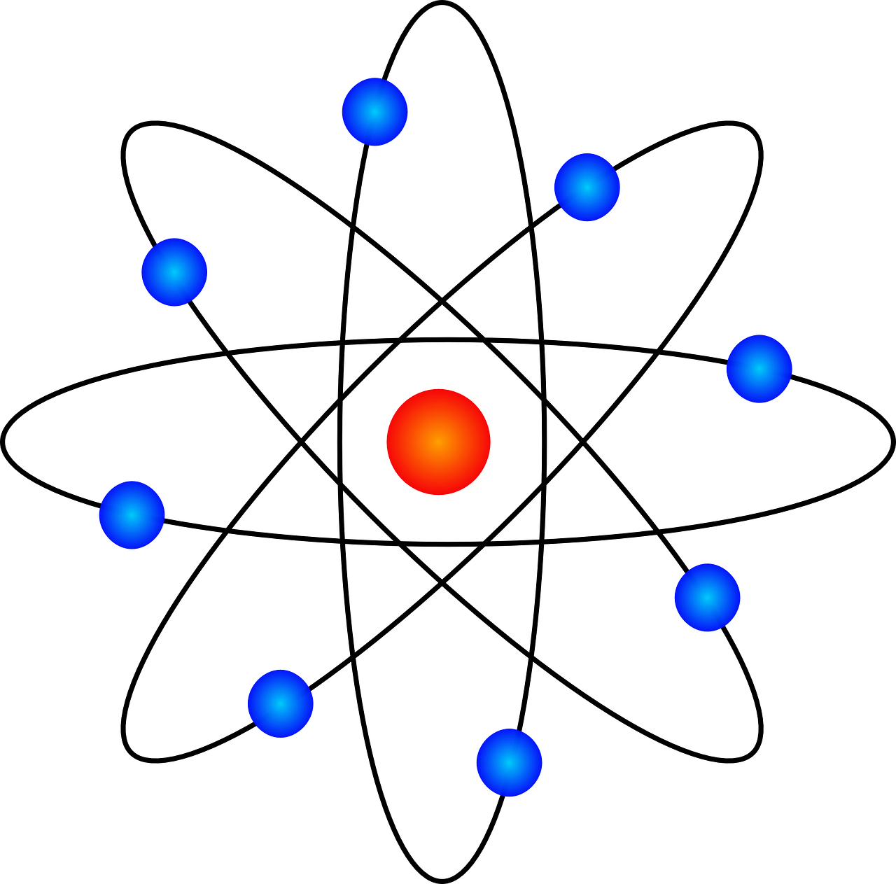
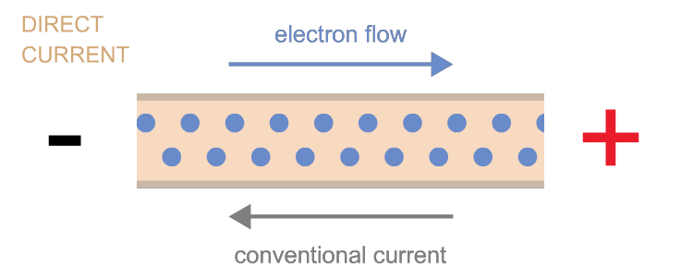
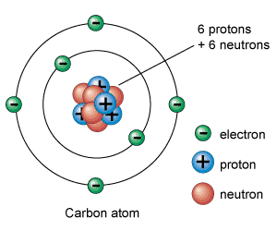
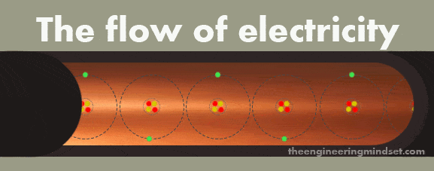
Electron

Slide 7
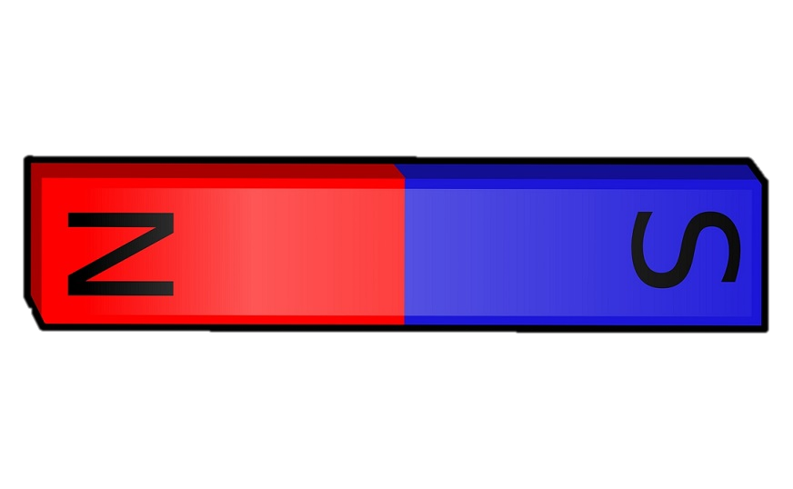
Magnet

Slide 8

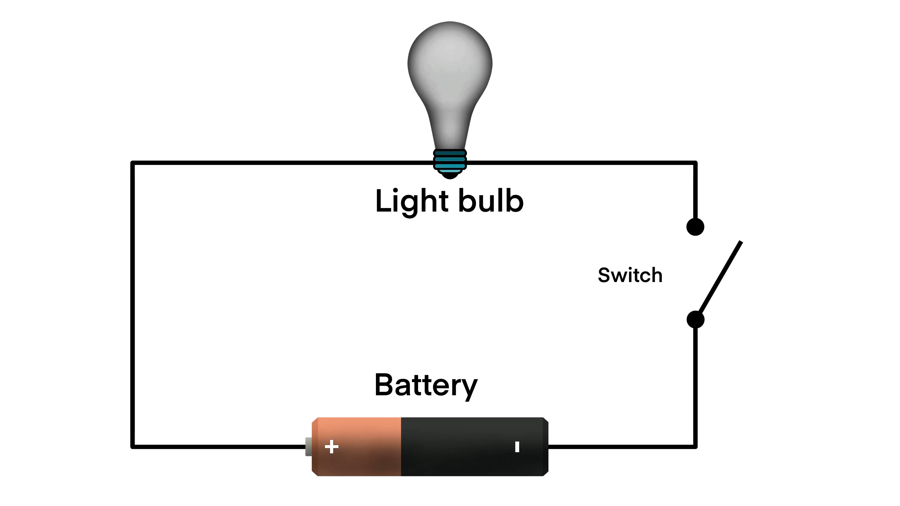

Slide 9
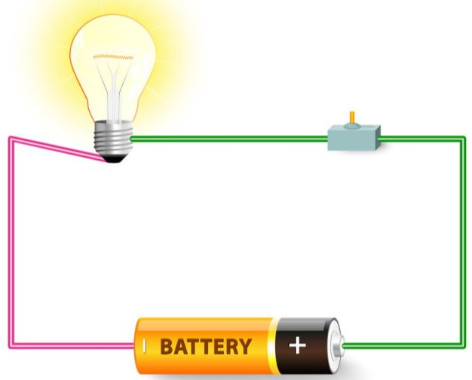
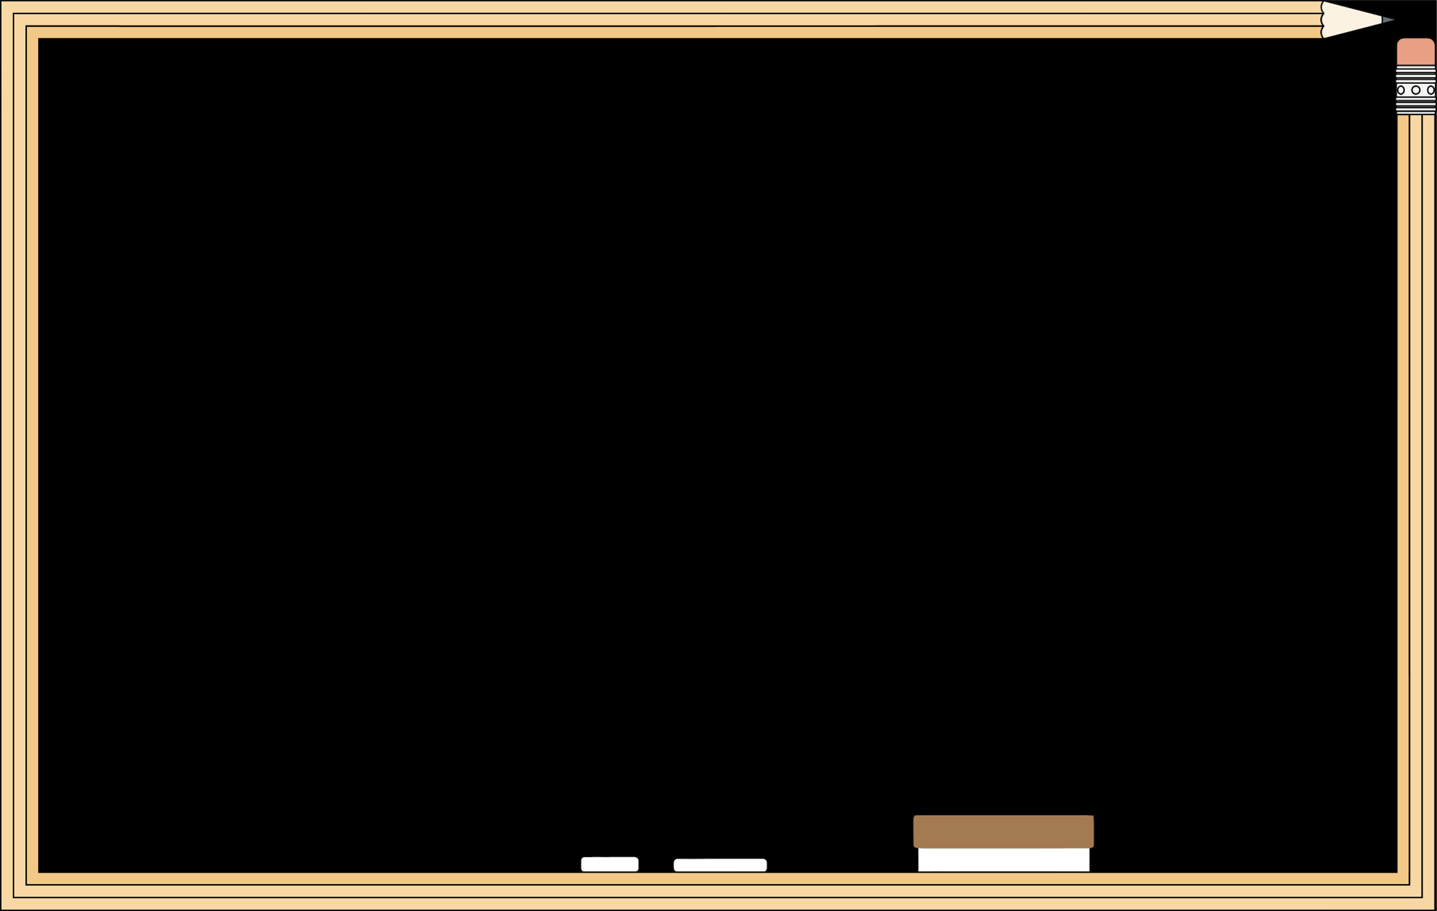
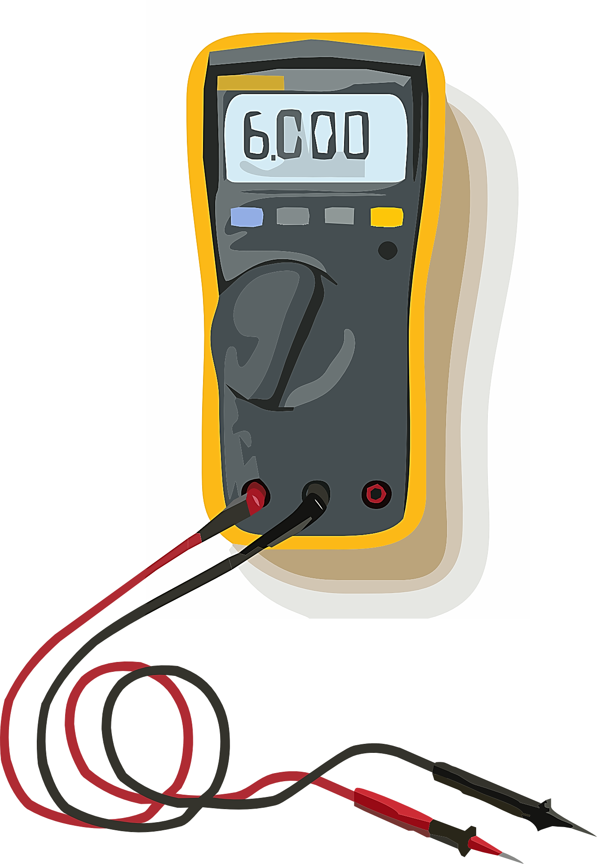


V = 12 volt
I = 6 AMP
$$R= \frac{V}{I}= \frac{12}{6}=2 Ω$$
W$=V ∗I=12∗6=72 watt$

Slide 10
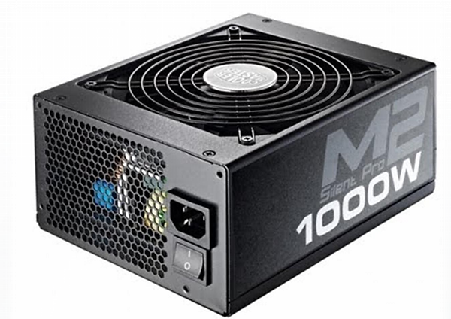

Slide 11
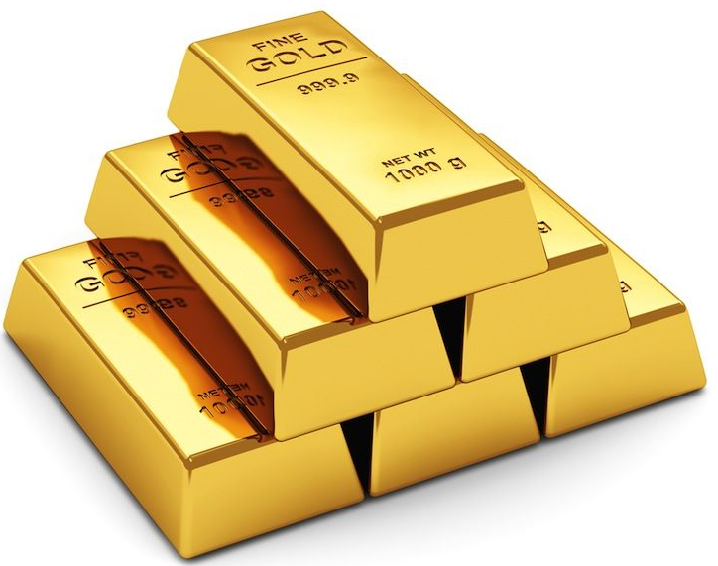
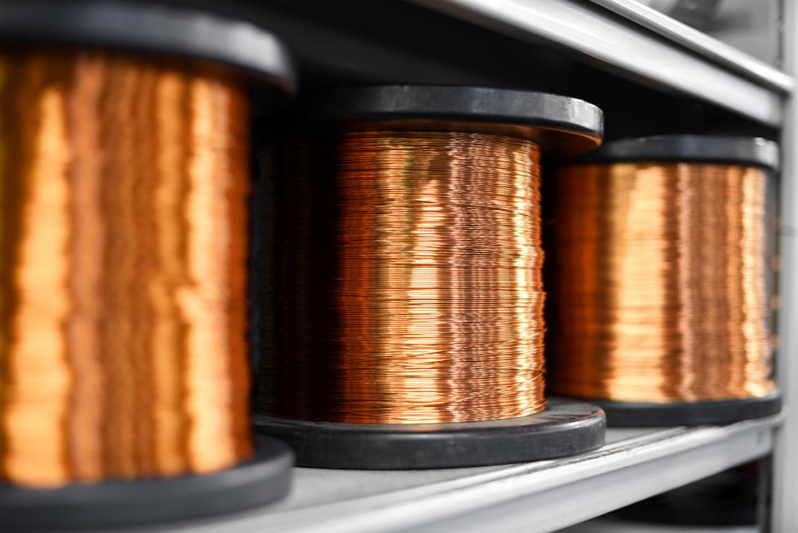
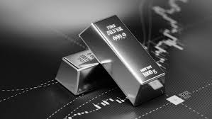
Conductor
Copper
Silver
Gold

Slide 12
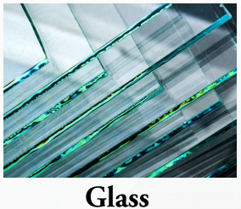
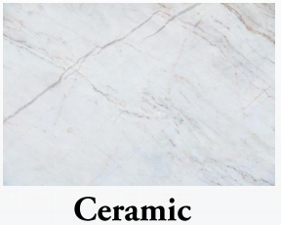
Insulator

Slide 13
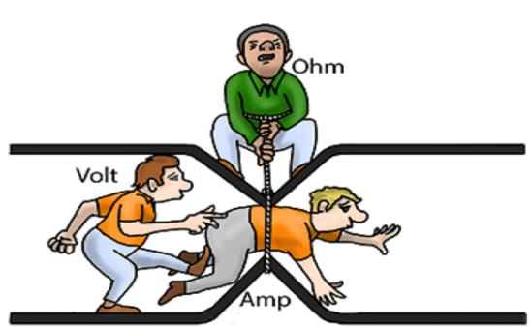
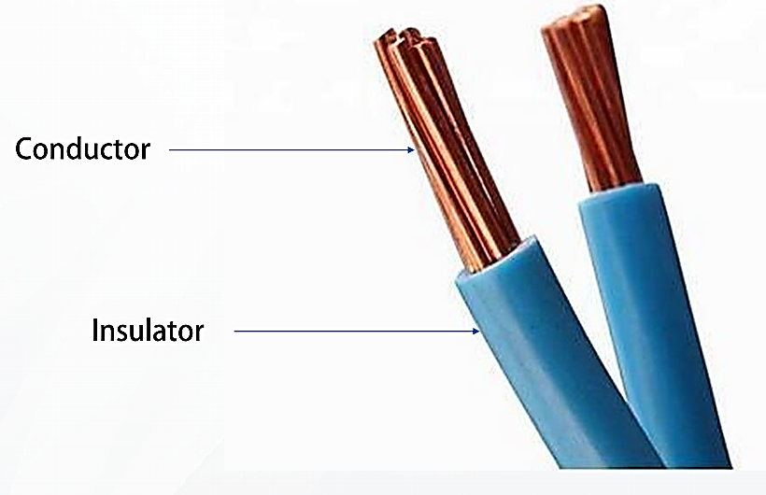

Slide 14
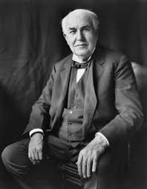
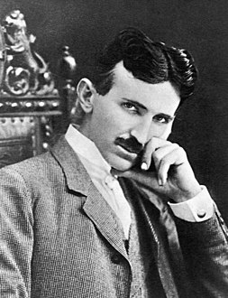
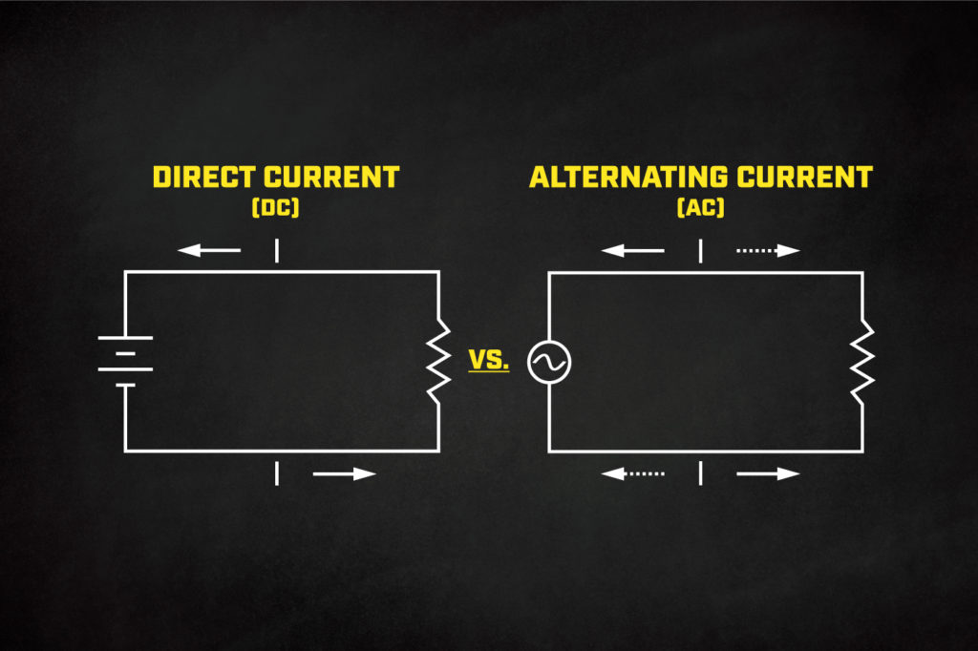
Direct current alternating current

Slide 15
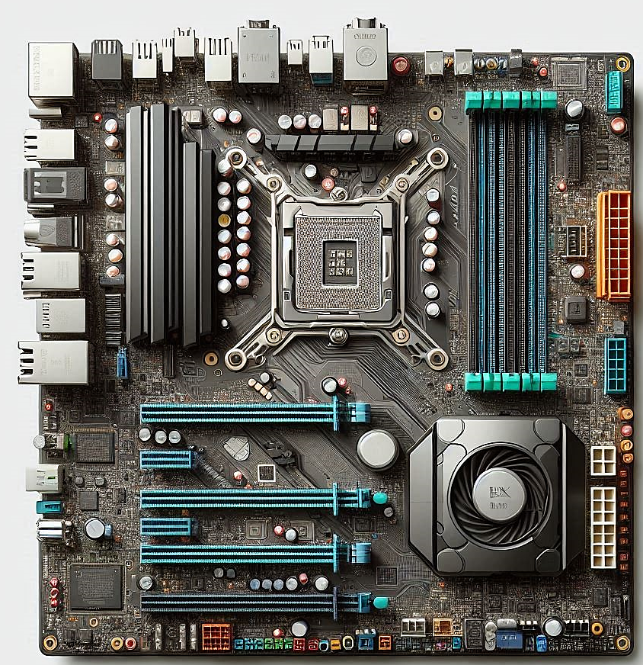
The direct current
is used in the motherboard

Slide 16

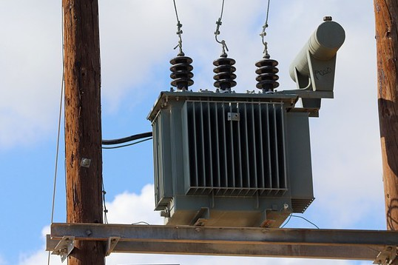
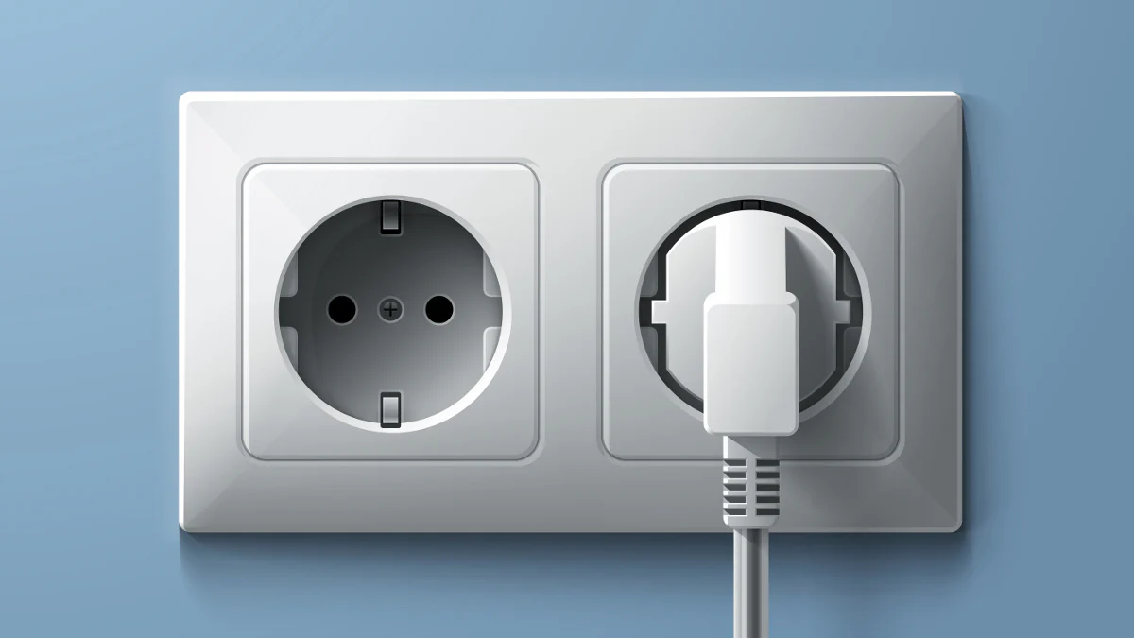
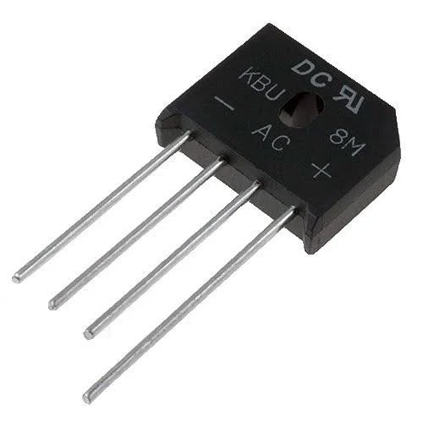
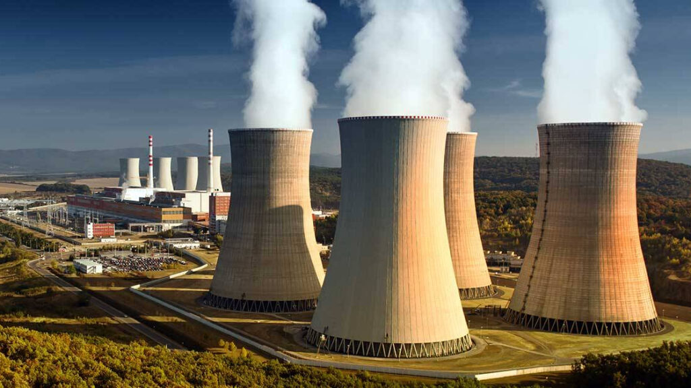

Slide 17
Transform
PSU
+5 V
+12 V
Alternative current (220V)
+3.3
-12 V

Slide 18
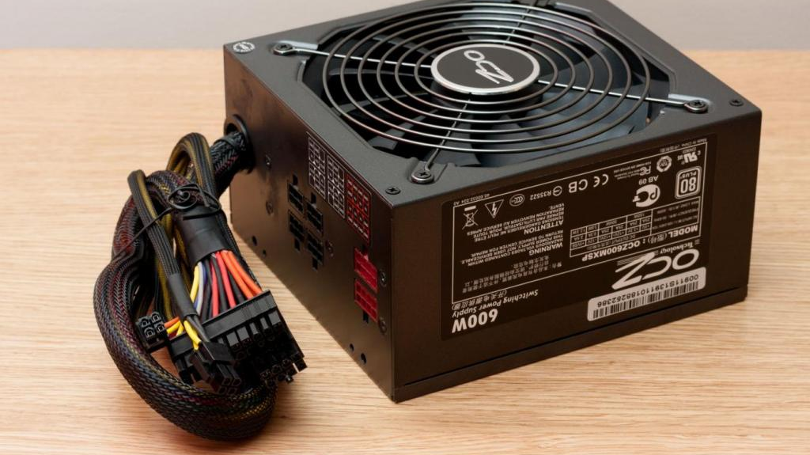
Power supply feature

Slide 19
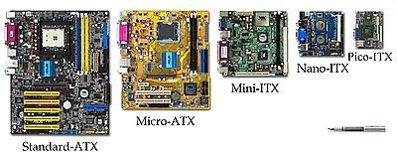
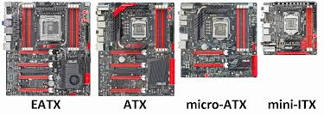
1- Form factor

Slide 20
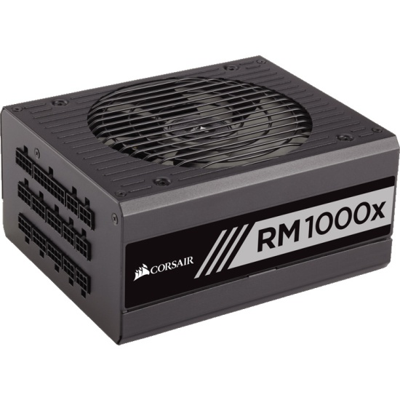
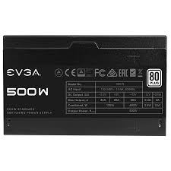
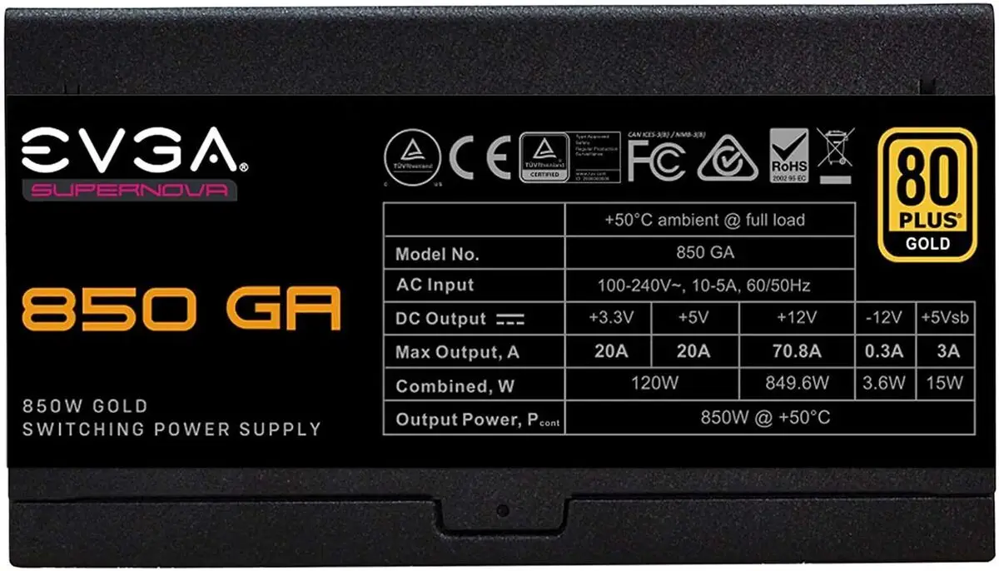
2- Wattage Ration
12 V
Rail

Slide 21
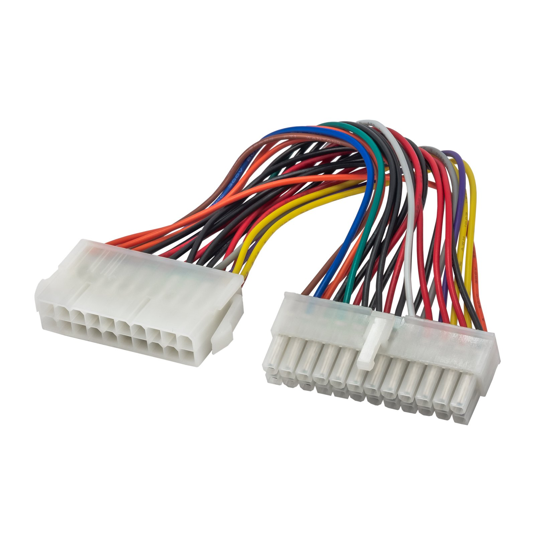
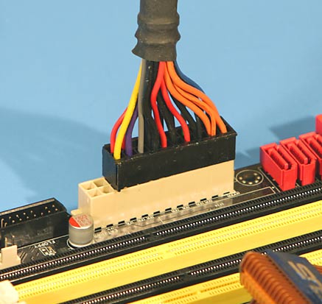
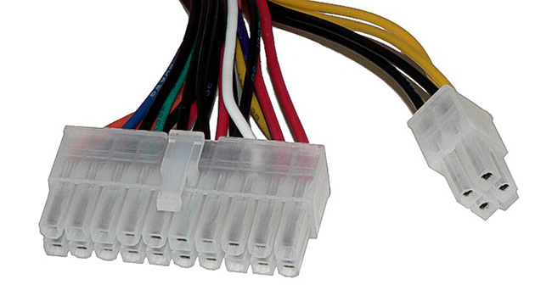
3- Number and type of connector
P1 connector

Slide 22
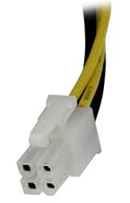
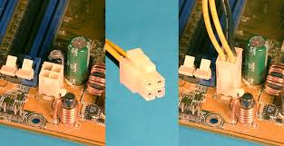

3- Number and type of connector
4 pin 12v ATX connector

Slide 23


3- Number and type of connector
molex 4-pin connectors

Slide 24



3- Number and type of connector
SATA Connector

Slide 25



3- Number and type of connector
Floppy drive Connector

Slide 26


3- Number and type of connector
6 pin 12-volt PCI connector

Slide 27


Slide 28

4. Fan inside the PCU

Slide 29

5. Dual Voltage Option

Slide 30


Another feature
Warranty
Modular VS Non-Modular
Gaming computer support
protection

Slide 31


How to calculate to wattage capacity
Automatic
Click here

Slide 32

Example
High end and mother board
Two high-end video cared using lets technology
Two SATA hard disk
DVD-RM
Four case fans
Four case fans
ATX Power Supply at least 800 watt

Slide 33

Tank you

